Slide 1
Recreating FAMOUS WORKS of ART: STILL LIFES, SCULPTURES, ANIMALS and LANDSCAPES

Slide 2
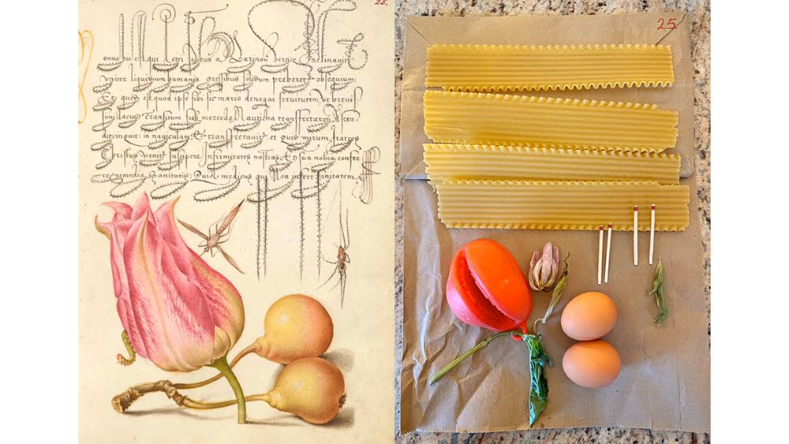

Slide 4
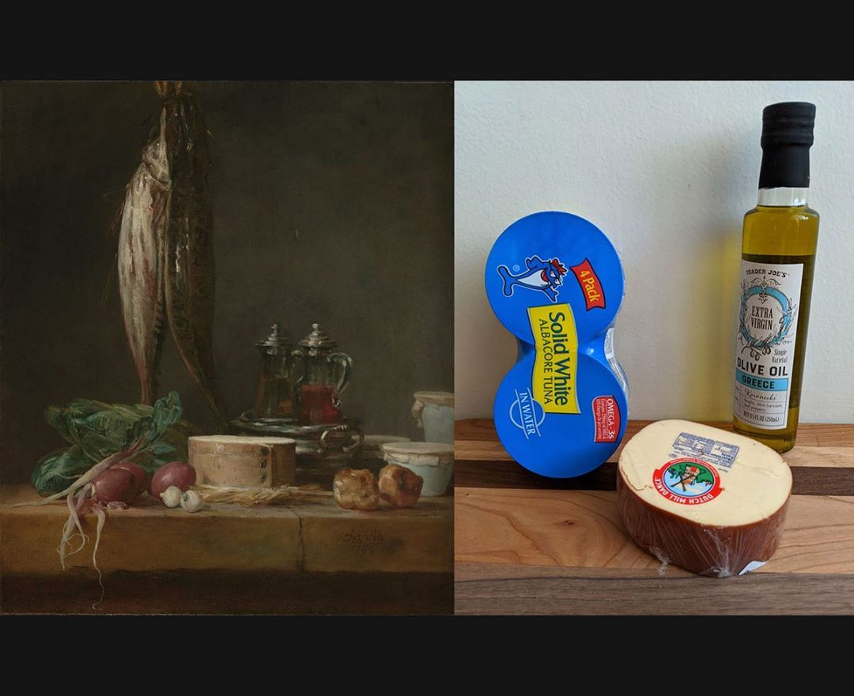

Slide 5
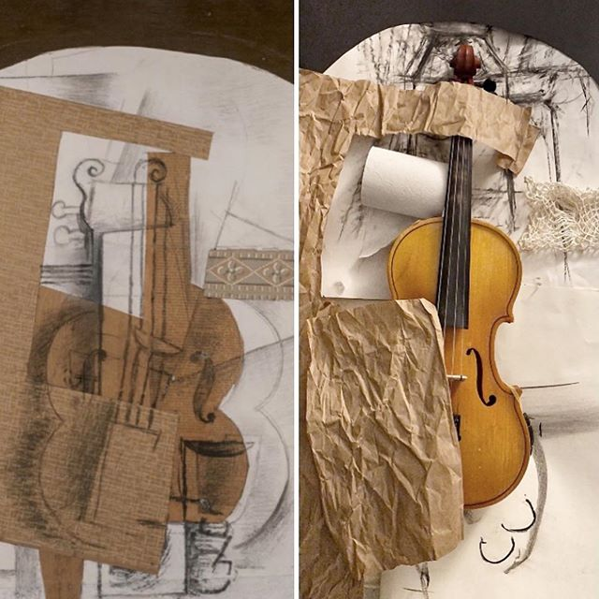

Slide 6
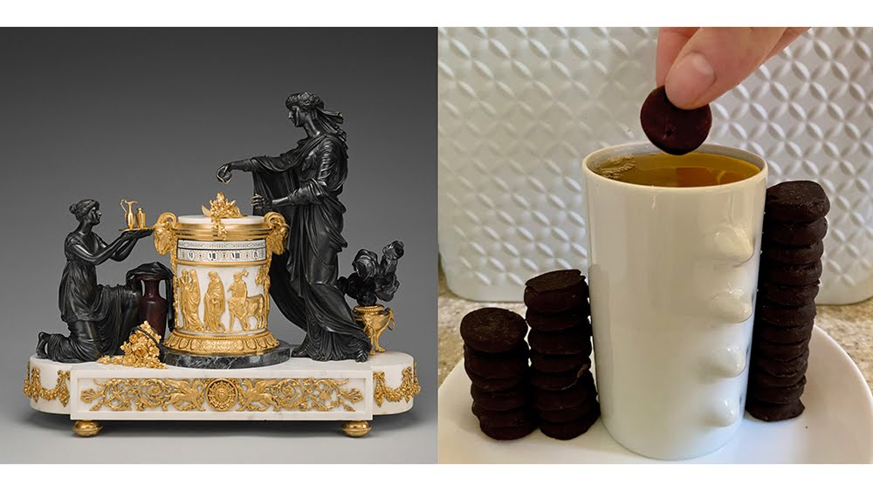

Slide 8
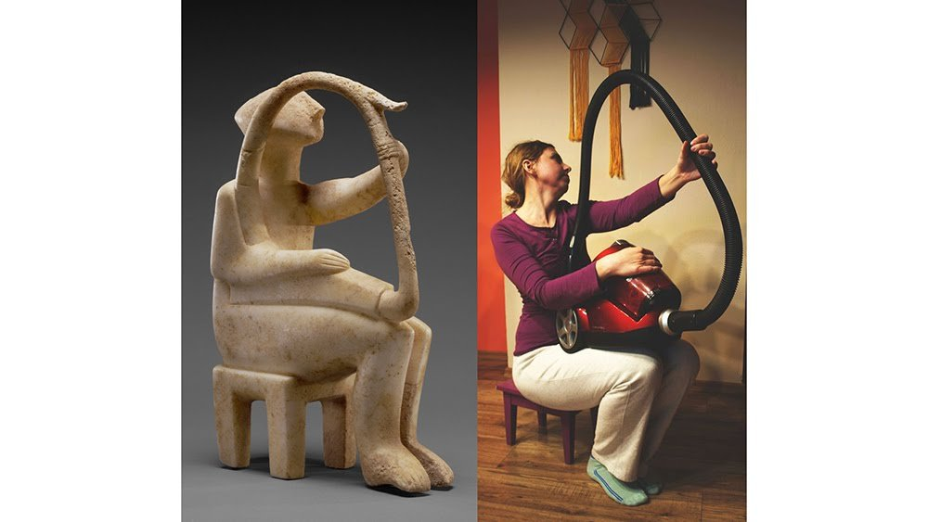

Slide 10
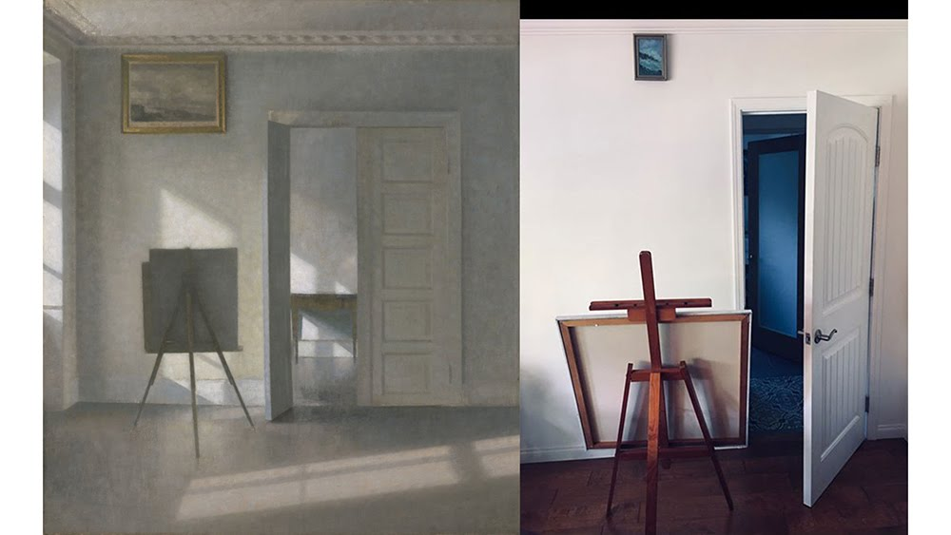

Slide 11
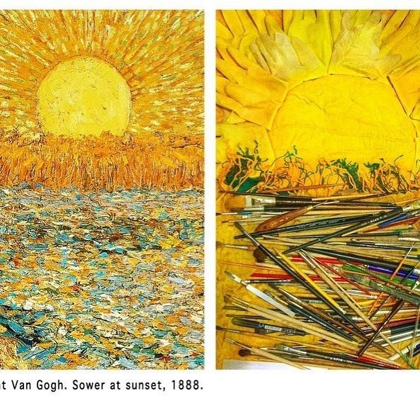

Slide 12
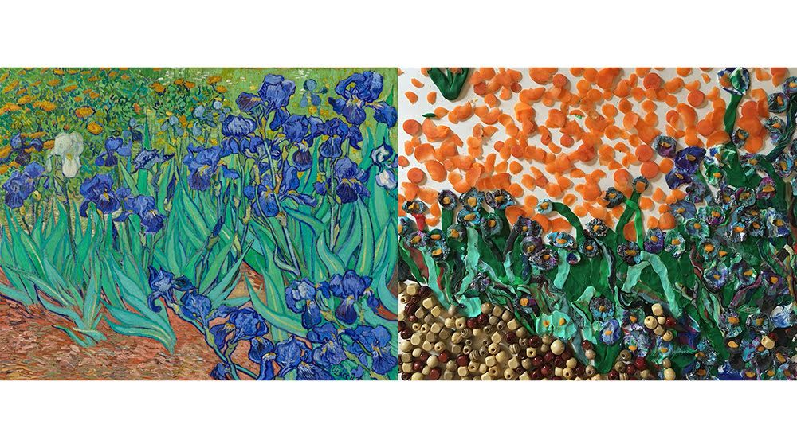

Slide 14
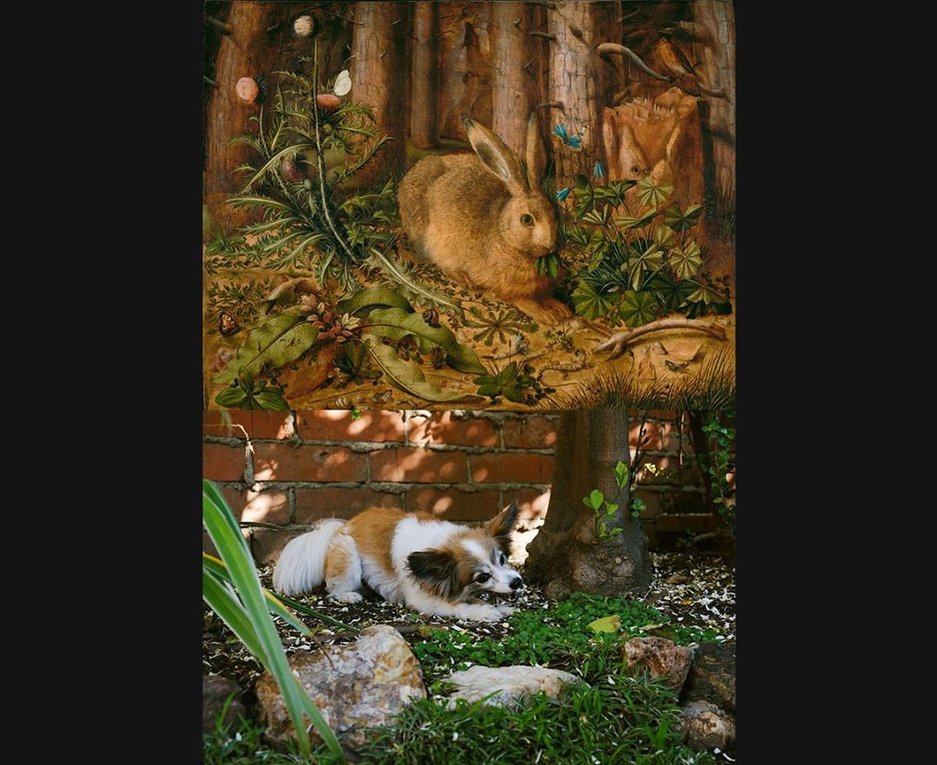

Slide 15
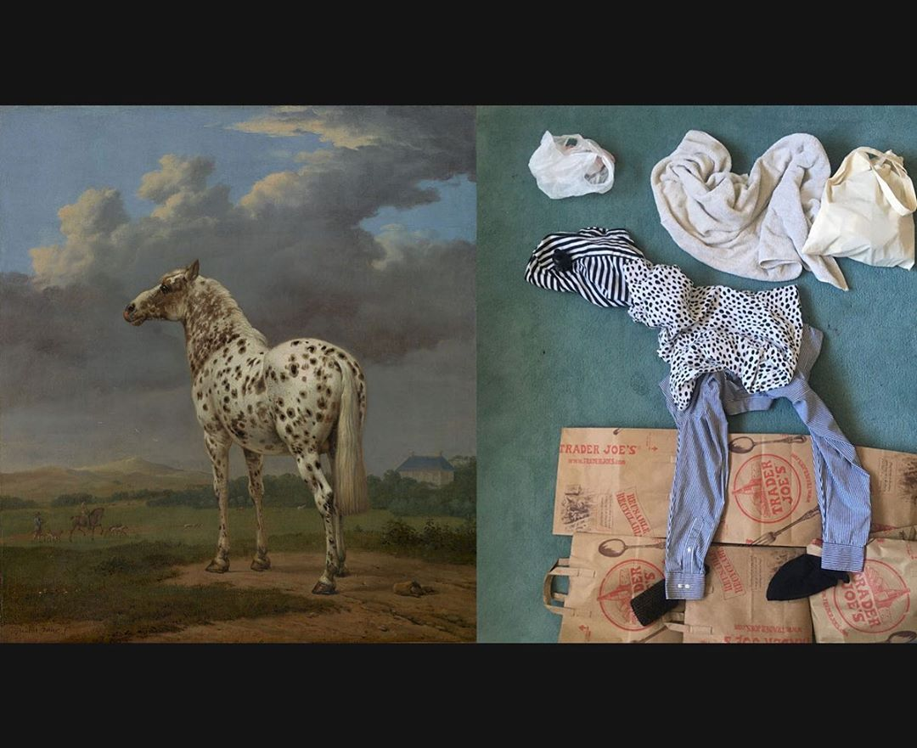

Slide 16
https://www.thisiscolossal.com/2020/04/covid-19-getty-recreations/
https://www.boredpanda.com/art-recreation-at-home-museum-challenge/?utm_source=google&utm_medium=organic&utm_campaign=organic
https://www.boredpanda.com/famous-painting-remakes/?utm_source=google&utm_medium=organic&utm_campaign=organic
https://news-artnet-com.cdn.ampproject.org/v/s/news.artnet.com/art-world/instagram-recreate-famous-artworks-1819776/amp-page?amp_js_v=a3&amp_gsa=1&usqp=mq331AQFKAGwASA%3D
https://www-refinery29-com.cdn.ampproject.org/v/s/www.refinery29.com/amp/en-us/2020/04/9689396/getty-museum-challenge-twitter?amp_js_v=a3&amp_gsa=1&usqp=mq331AQFKAGwASA%3D#aoh=15870801890187&referrer=https%3A%2F%2Fwww.google.com&amp_tf=From%20%251%24s&ampshare=https%3A%2F%2Fwww.refinery29.com%2Fen-us%2F2020%2F04%2F9689396%2Fgetty-museum-challenge-twitter
https://www.demilked.com/people-recreate-art-at-home/
https://www.sadanduseless.com/recreated-art/
https://amp-classicfm-com.cdn.ampproject.org/v/s/amp.classicfm.com/discover-music/humour/recreating-famous-paintings-home-quarantine/?amp_js_v=a3&amp_gsa=1&usqp=mq331AQFKAGwASA%3D#aoh=15870801890187&referrer=https%3A%2F%2Fwww.google.com&amp_tf=From%20%251%24s&ampshare=https%3A%2F%2Fwww.classicfm.com%2Fdiscover-music%2Fhumour%2Frecreating-famous-paintings-home-quarantine%2F

